Slide 1
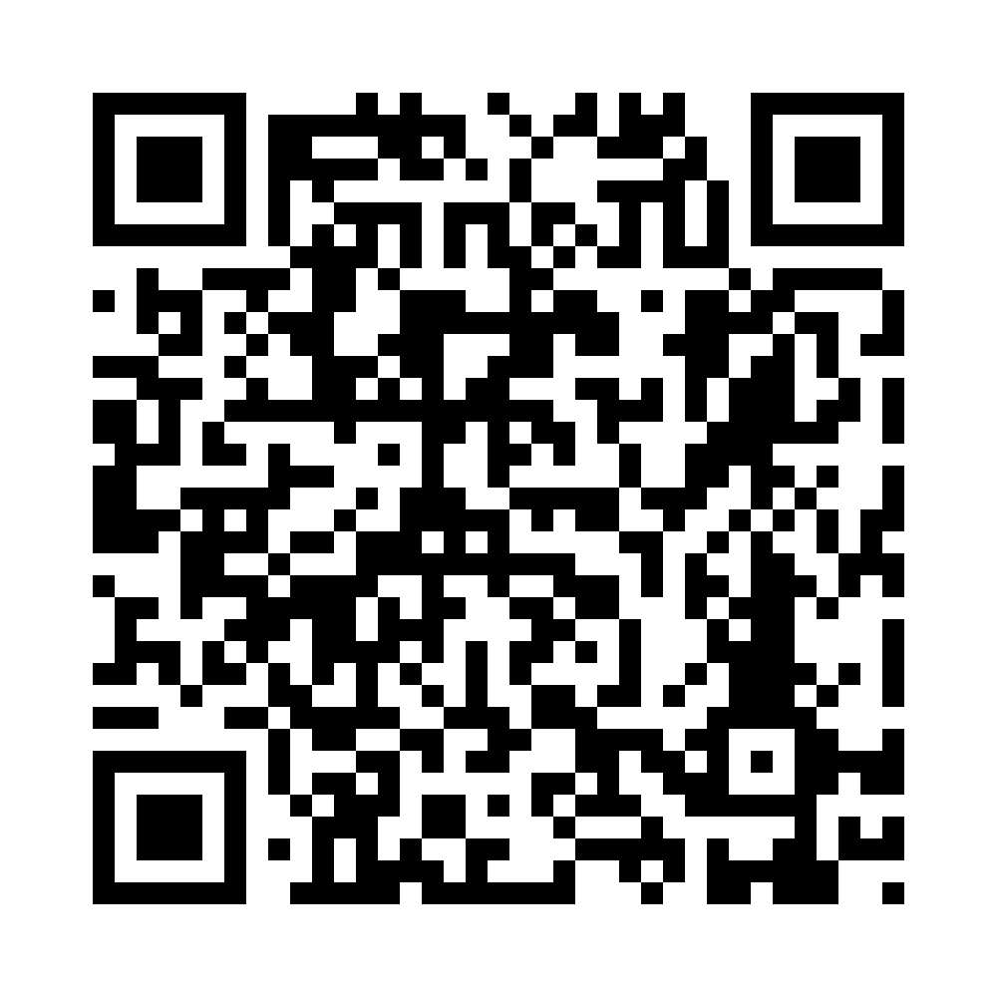
Gies AI Strategy Update
Dean’s Strategic Operations Council
December 2025
https://go.gies.illinois.edu/AIStrategyFull

Slide 2
Table of Contents
Gies AI Journey
Faculty Needs & Solutions
State of AI Learning
Campus AI Literacy Framework
Curriculum Opportunities

Slide 3
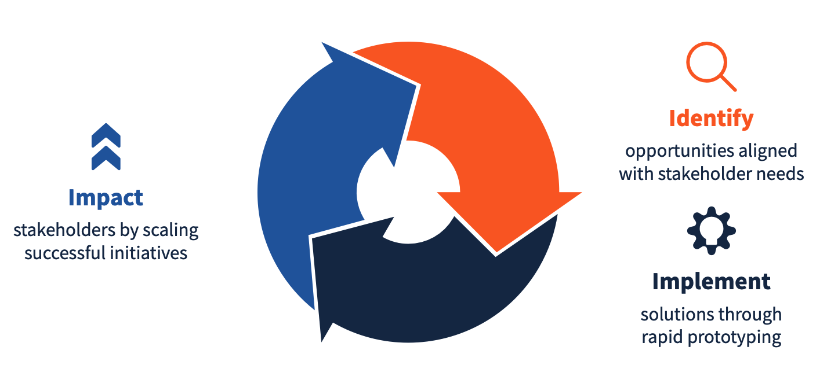
Gies AI Journey
Gies AI Taskforce charged in Summer 2025 to define a strategy to continuously identify, pilot, build, and implement AI for IMMEDIATE impact on learners, faculty, staff, and alumni
Gies AI Strategy and Gies AI Values are being finalized for launch in Spring 2026
Immediate need for curriculum and academic integrity work to keep pace with landscape & campus initiatives

Slide 4
Gies AI Journey
Gies AI Task Force
Campus AI Curriculum Task Force
AI & Academic Integrity (iDegrees)
BADM AI Committee
Gies AI Curriculum Task Force
Gies AI Curriculum Task Force (charge letter)
BADM AI Committee (faculty survey report)
iDegrees AI & Academic Integrity Committee formed to assess issue in online degrees
Dec 2025 Gies x Google whiteboarding session
Feedback indicates interest in partnering with Google for faculty training, pilot AI credits, and expanded AI capabilities with Google Gemini, Notebook LLM, Vertex AI

Slide 5
Gies AI Curriculum Task Force Charge
Curriculum
Resources & GOVERNANCE
Develop an AI competency framework for the Gies Business context
Determine how to deliver AI fluency and responsible-use skills to all Gies learners
Determine how to deliver discipline-specific applied AI skills through course integrations and/or standalone offerings
Review and integrate AI in existing and proposed business analytics offerings
Market and career insights
Faculty training and resources
AI tools for learners and faculty
AI and assessment of learning
Governance structures
External partnerships

Slide 6

Faculty Needs
Need for training and lack of time are primary constraints for faculty
Top need requests from faculty are:
AI tools in a secure, private ecosystem
Guidelines for responsible use of AI by students
AI resources for research (e.g., tools, free AI tokens)

Slide 7
Some Solutions
Partner with external partners like Google or OpenAI to provide secure AI tools, training, and research resources
Reduce time constraint by introducing Gies AI Fellowships (proposed track in the Gies Faculty Innovation Scholars program)
Enhance faculty awareness of resources
Create online “Hub” of AI resources with T&L and I&T as joint coordinators
AI-focused section in Bottom Line

Slide 8
State of AI Learning @ Gies
Stand-alone AI courses / programs*
MSBAi, Applied AI track
AI in Business (iMBA)
Quantum computing for mgrs.
AI and Leadership
AI integrations (examples)
BUS 101
Experiential Learning
Data analytics
Teaching with AI
Digital avatars & voiceprints
AI dubbing for MOOCs
Syllabi guidance
AI-assisted grading
Use of AI in creation of assessments (e.g., Examind)
* Includes existing and proposed courses / programs

Slide 9
State of AI Learning @ U of I
100+ courses on AI, LLMs, and AI ethics from Grainger, iSchool, Gies, ACES, LAS, Library, and Law
Several AI MOOCs on Coursera from ACES and Gies (~18,000 enrollments)
Intro & Advanced AI in Business
Digital Marketing Strategy with AI
AI in Wealth Management
AI in Financial Planning
Advanced Dairy Management with AI

Slide 10
🧠 Siebel School of Computing & Data Science
AI for All (100-level, AI Literacy and Use, in development)
Adapting AI (300-level, knowledge work with AI for non-engineers)
Building Tools with Agentic AI (400-level, using modern AI agent platforms; course of non-engineers under consideration)
Executive AI Workshops (for upskilling)
🤖 School of Information Sciences (iSchool)
Undergraduate courses:
Demystifying AI (introductory)
Mapping Inequalities: The Foundations of Sociotechnical Critique
Intro to Generative AI for Human–AI Collaboration
Concepts of Machine Learning (non-computational)
Deep Learning (advanced)
Social Network Analysis
Social Systems Dynamics
Modeling Social Systems
Decision Analysis and Modeling
AI Governance
Data Governance
Data Storytelling (Intro and Advanced)
Data Visualization (advanced)
Graduate & proposed courses:
AI Beyond Machine Learning
AI and Society
AI and Data Curation
Responsible Data Science and AI
Multimodal Machine Learning (Fall 2026, on vision-language and LLMs)
📊 Gies College of Business
ACCY 593: AI in Business: Fundamentals, Applications, and the Future (Graduate level, fully online, MOOCs hosted on Coursera)
Proposed courses on quantum computing for managers and leadership with AI (both graduate level, online)
Other data science / analytics courses:
Machine learning
Data analytics
Emerging technologies
Regression and statistics
AI integrated into digital marketing, analytics, and practicum courses
In-house faculty AI training resources and syllabus guidance for AI use
🌱 ACES
Computer Vision for Animal Welfare
Coursera hosted MOOCs on AI in dairy farming, financial planning, etc
🎓 College of Education
Multiple AI-related courses spanning:
Learning Design & Leadership (LDL)
Educational Philosophy (EPOL)
Focuses on philosophical and pedagogical aspects of AI
AI integrated into courses on design and use of Ed Tech
📚 University Library & CITL
CITL Generative AI Fluency open course
Workshops on:
Intro to AI
AI for qualitative research
AI in evidence-based synthesis
Canvas modules and AI integration guides
Short guides for AI use in research (undergrad through graduate)

Slide 11
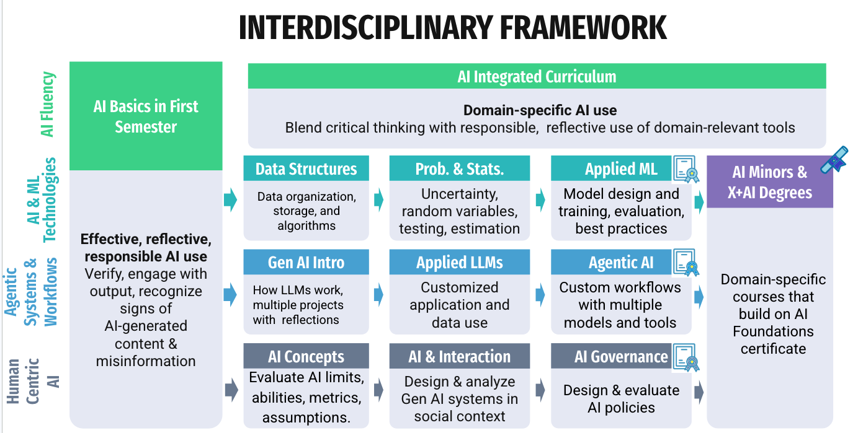
Campus AI Literacy Framework (Draft)

Slide 12
Campus AI Curriculum Opportunities
AI Fundamentals
UG Gen Ed AI Course (“AI for All”)
AI integration in 100- to 200- level courses across units (e.g., CS 105)
College-level foundational electives
Non-credit bearing open content (e.g., CITL Gen AI Fluency course)
AI & ML Technologies
AI / ML concepts, LLM basics
Design, train, build AI models
Agentic Systems & Workflows
Basic and intermediate coding skills
Courses on how to build agentic AI systems for engineers & non-engineers
Courses on agentic AI tools and systems in discipline-specific domains
Human Centered AI
Courses on AI / data governance, AI in social systems, AI and sustainability, and the design of AI policies

Slide 13
Gies AI Curriculum Opportunities
AI Fundamentals
AI integration in 100- to 200- level courses across Gies (e.g., BUS 101)
Applied AI integrations with business use cases in elective courses (AI + Gies X)
AI ethics in the business context
Non-credit bearing open content and industry skills content
AI & ML technologies
AI / ML concepts and basics of LLMs
Agentic AI Systems & Workflows
Generative and agentic AI tools in specific business disciplines
The role of agentic AI in HR / people management
Human Centered AI
Courses or integrated content on AI and sustainability / social issues and on the audit and governance of AI systems

